Slide 1
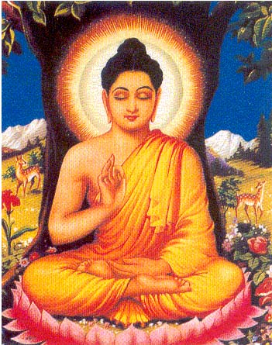
By: Chris Orlando

Slide 2
IS BUDDHISM A RELIGION?
REVIEW: WHAT WAS OUR CLASSROOM DEFNITION OF “RELIGION”?

Slide 3
IS BUDDHISM A RELIGION?
NO ‘GOD-NOTION’
NO CREATOR
DOES NOT SEEK TO BE ‘SAVED’

Slide 4
ESSENCE:
Buddhism is a way of life/religion
Ethical
Psychological
Philosophy of BECOMING/AWAKENING

Slide 5
YOU DECIDE!!!
REVIEW: Does Buddhism fit our definition of religion?
If not, should we change our definition?

Slide 6
BUDDHIST ALTARS
Don’t focus on mother or father image
Rather, a psychological state
Profound meditation
Warm compassion
Fury against illusion
**What is an “altar”?

Slide 7
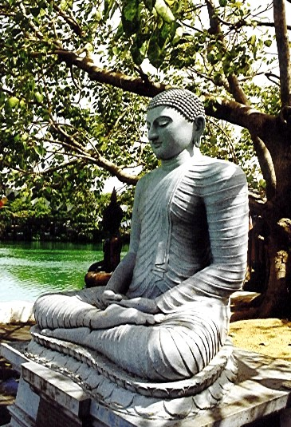
Buddha
under
Bodhi
Tree,
Sri
Lanka

Slide 8
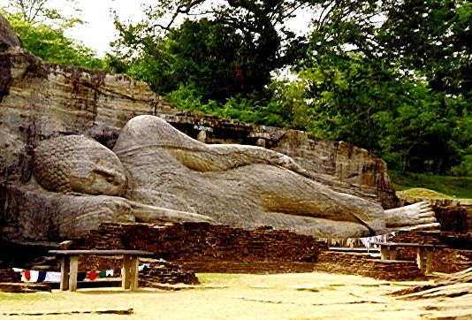
8
Gal Vihara, Polannaruwa. The Buddha is dying

Slide 9
1993 CHICAGO PARLIAMENT OF THE WORLD RELIGIONS
“The Buddha, the founder of Buddhism, was not God or a god. He was a human being who attained full enlightenment through meditation and showed us the path of spiritual awakening and freedom. Therefore, Buddhism is not a religion of God. Buddhism is a religion of wisdom, enlightenment and compassion. Like the worshippers of God who believe that salvation is available to all through confession of sin and a life a prayer, we Buddhists believe that salvation and enlightenment are available to all through the removal of delusion and a life of meditation/ However, unlike those who believe in God who is separate from us, Buddhists believe that Buddha, which means ‘one who is awake and enlightened’ is inherent in us all as Buddhanature or Buddhamind.”

Slide 10
BUDDHA AND ‘ULTIMATE QUESTIONS’
Nature of the soul
Life after death
Origin of the universe
NOT ADDRESSED
**Do other religions address these questions

Slide 11
ANALOGY:
BUDDHA TEACHINGS = RAFT
SHORE = NIRVANA
BUT: THE SHORE IS NOT DESCRIBED
MAKE-UP OF RAFT IS THE BUDDHA’S TEACHINGS

Slide 12
FIRST NOBLE TRUTH:
LIFE INEVITABLY INVOLVES SUFFERING:
Imperfect
Illness
Hateful
Separation

Slide 13
SECOND NOBLE TRUTH:
THE ORIGIN OF SUFFERING IS OUR DESIRES:
Grasping for pleasure
Grasping for becoming
Grasping for sensual delight
Grasping for what we don’t have

Slide 14
THIRD NOBLE TRUTH:
SUFFERING WILL STOP WHEN DESIRES ARE STOPPED:
When the ‘grasping’ stops
Elimination of passions

Slide 15
FOURTH NOBLE TRUTH:
THERE IS A WAY TO GET TO THIS POINT: THE EIGHTFOLD PATH

Slide 16
1) RIGHT UNDERSTANDING
Understanding reality through the Four Noble Truths
Seeing through illusions

Slide 17
2) RIGHT THOUGHT/MOTIVES
Uncover ‘unwholesome’ emotional roots that guide our thinking
Discover and weed out
Only then do we become free from self-centredness

Slide 18
3) RIGHT SPEECH
VS. - Vain talk, gossip, harsh words, lying
Communication must further truth and harmony
Including ‘self-talk’: “May you be well and happy today…”

Slide 19
4) RIGHT ACTION
FIVE RULES OF MORAL CONDUCT:
DO NOT DESTROY LIFE
DO NOT STEAL
AVOID SEXUAL MISCONDUCT
DO NOT LIE
DO NOT USE INTOXICANTS
ABOVE ALL: ALL ACTIONS SHOULD BE BASED ON CLEAR UNDERSTANDING

Slide 20
5) RIGHT LIVELIHOOD
How one makes their living
One’s work should not harm others

Slide 21
6) RIGHT EFFORT
Refers to the constant effort that must be put into achieving these goals
IT TAKES EFFORT!

Slide 22
7) RIGHT MINDFULNESS
The way to liberation is through the mind
“CHECK YOUR MIND
BE ON GUARD
PULL YOURSELF OUT
LIKE AN ELEPHANT FROM THE MUD.”

Slide 23
8) RIGHT MEDITATION
Applying mental discipline to quiet the mind
THE MIND IS SUBTLE, INVISIBLE, AND TREACHEROUS
USE SKILFUL MEANS TO SEE AND UNDERSTAND ITS NATURE

Slide 24
KARMA:
CAUSE OF NEXT LIFE = KARMA

Slide 25
NIRVANA
“No suffering for him
Who is free from sorrow
Free from the fetters of life
Free in everything he does
He has reached the end of his road…
Like a bird invisibly flying in the sky
He lives without possessions
Knowledge his food, freedom his world
While others wonder…
He has found freedom –
Peaceful his thinking, peaceful his speech
Peaceful his deed, tranquil his mind.”

